Slide 1

Integrating React with TMDB API and LocalStorage
Pantea Namiranian
The University of Arizona Global Campus
INT499: Capstone for Information Technology (INP2520A)
John Russell
6/1/2025
Notes:
Hello everyone! My name is Pantea Namiranian.
Today, I will be discussing our project that focuses on integrating a React application with the TMDB API and utilizing localStorage for an enhanced user experience.

Slide 2

Introduction
Demonstrate the features and functionalities of the StreamList React application that integrates a React application with the TMDB API.
LocalStorage usage to enhance user experience by saving data across sessions
Notes:
This presentation showcases the StreamList application that integrates a React application with the TMDB API. We’ll also discuss how we use localStorage to enhance user experience by saving data across sessions.

Slide 3
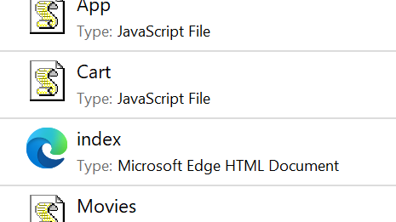
Project Overview
Display movie data retrieved from the TMDB API on a dedicated page.
2
Provide users with a comprehensive movie browsing experience.
3
Allow users to search for movie information directly within our application.
1
Notes:
The main objective of this project is to allow users to search for movie information seamlessly within our application. We will display the movie data retrieved from the TMDB API on a dedicated page. By integrating this API, we aim to provide users with a comprehensive and enjoyable movie browsing experience.

Slide 4
Integrating TMDB API
Connect the React app with the TMDB API to fetch movie data.
Users search for movies will be displayed on a separate page.
Allows users to access detailed information about movies they are interested in.
Notes:
In our application, we connect to the TMDB API, which allows us to fetch a wide range of movie data. Users can search for movies, and the results will be displayed on a separate page. This integration empowers users to access detailed information about the movies they are interested in, enhancing their overall experience.

Slide 5
LocalStorage Implementation
Implemented localStorage
Improve user experience
Keep user input and selections after refreshing the page
Minimizes frustration and enhances usability
Notes:
To further improve the user experience, we have implemented localStorage in our application. This feature allows users to keep their input and selections even after they refresh the page. For instance, if a user adds a movie to their list, it will remain visible after the page refreshes. This functionality minimizes frustration and enhances usability, making the application more user-friendly.

Slide 6
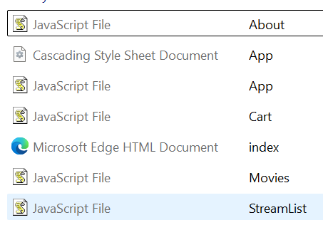
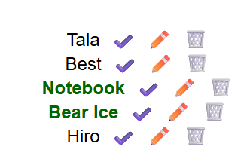
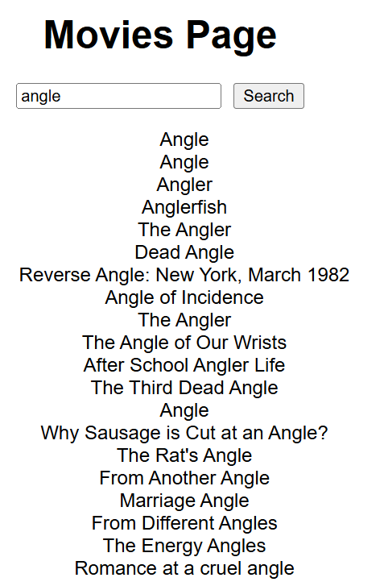
Code Overview
About.js
Manages routing between different components like StreamList, Movies, Cart, and About.
App.js
Displays information about the application
Add movies capability and utilizes localStorage to save data.
StreamList.js
Notes:
Now, let’s take a brief look at some key components of our application.
First, we have About.js, which displays information about the application.
Next, App.js manages routing between different components, such as StreamList, Movies, Cart, and About.
Finally, StreamList.js allows users to add movies to their list and utilizes localStorage to save their data, ensuring that their selections persist across sessions.

Slide 7
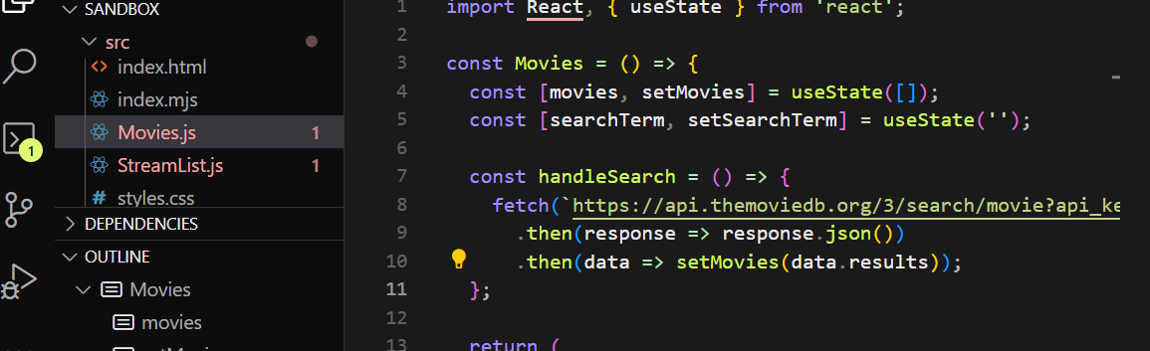
StreamList Component
Allows users to add movies to their list.
Handle user input and maintain the list using localStorage.
Ensures not lose data when refresh the page.
Notes:
The StreamList component is crucial as it allows users to add movies to their list. We handle user input and maintain the list using localStorage, which ensures that users do not lose their data when they refresh the page.
The code snippet here shows how we set up the component. We use the useState hook to manage input values and the list of streams. Additionally, we retrieve saved streams from localStorage when the component mounts and sync the state with localStorage using the useEffect hook. This approach guarantees that users have a consistent experience

Slide 8
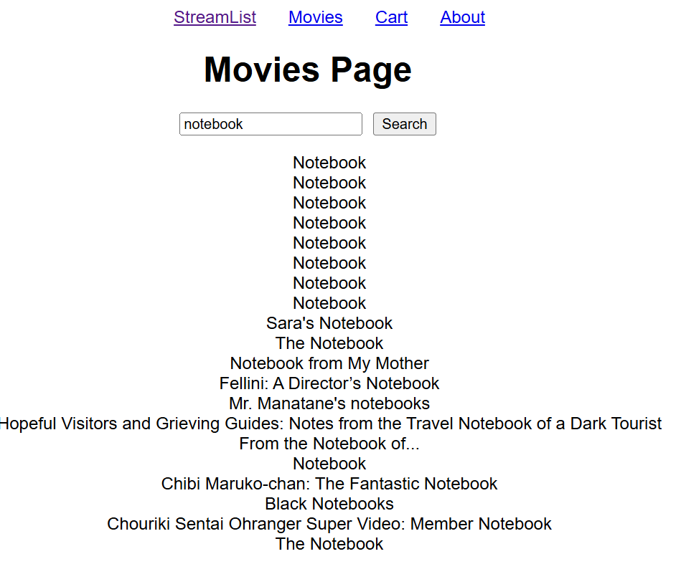
Conclusion
Here is a link to GitiHub and source of code:
Pantea-Namiranian-INT499-Week-3-Assignment-Part-1
Notes:
In conclusion, we have successfully integrated the TMDB API into our React application, providing users with easy access to movie information. By implementing localStorage, we ensure that user data is preserved across page refreshes, creating a smoother and more enjoyable experience.
Thank you for your attention! I am now happy to answer any questions you may have about the project.
Finally, Its time to see the live webpage and its features.

